Slide 1
Pairing Fonts

Slide 2
So many TypeFaces
When it comes to designing any media, choosing the typeface for the design is the toughest step because there are so many of them.
Notes:
Jostens schools have access to more than 200 fonts free of charge.
This number is continuing to grow.

Slide 3
Step 1 — Identify Needs
Decide what typographic elements might be needed on the page. This might included headlines, captions, etc.
Are you going to have any “fun” spreads?— plan for those too.

Slide 4
To Consider when Choosing FOnts
Mood of the font
Size, weight and position
Contrast
Notes:
Mood of the font: Each font reflects something differently (even subtly). Choosing a font requires attention to the small details of the font. Some fonts are classy, others are fun or edgy or decorative.
Size, weight and position: Altering the size, the weight and the position of the font can have a dramatic effect on the look and feel. For example, a light Helvetica font is drastically different from its bold counterpart, which in turn makes them a good pair (even if they are the same typeface).
Contrast: Much like the above, many fonts can contrast. For example, Impact (a common font found on Microsoft Word) is a very heavy font while Geneva is much lighter (even when bolded). Pairing fonts that contrast is often a good choice when planning the typography on the page.

Slide 5
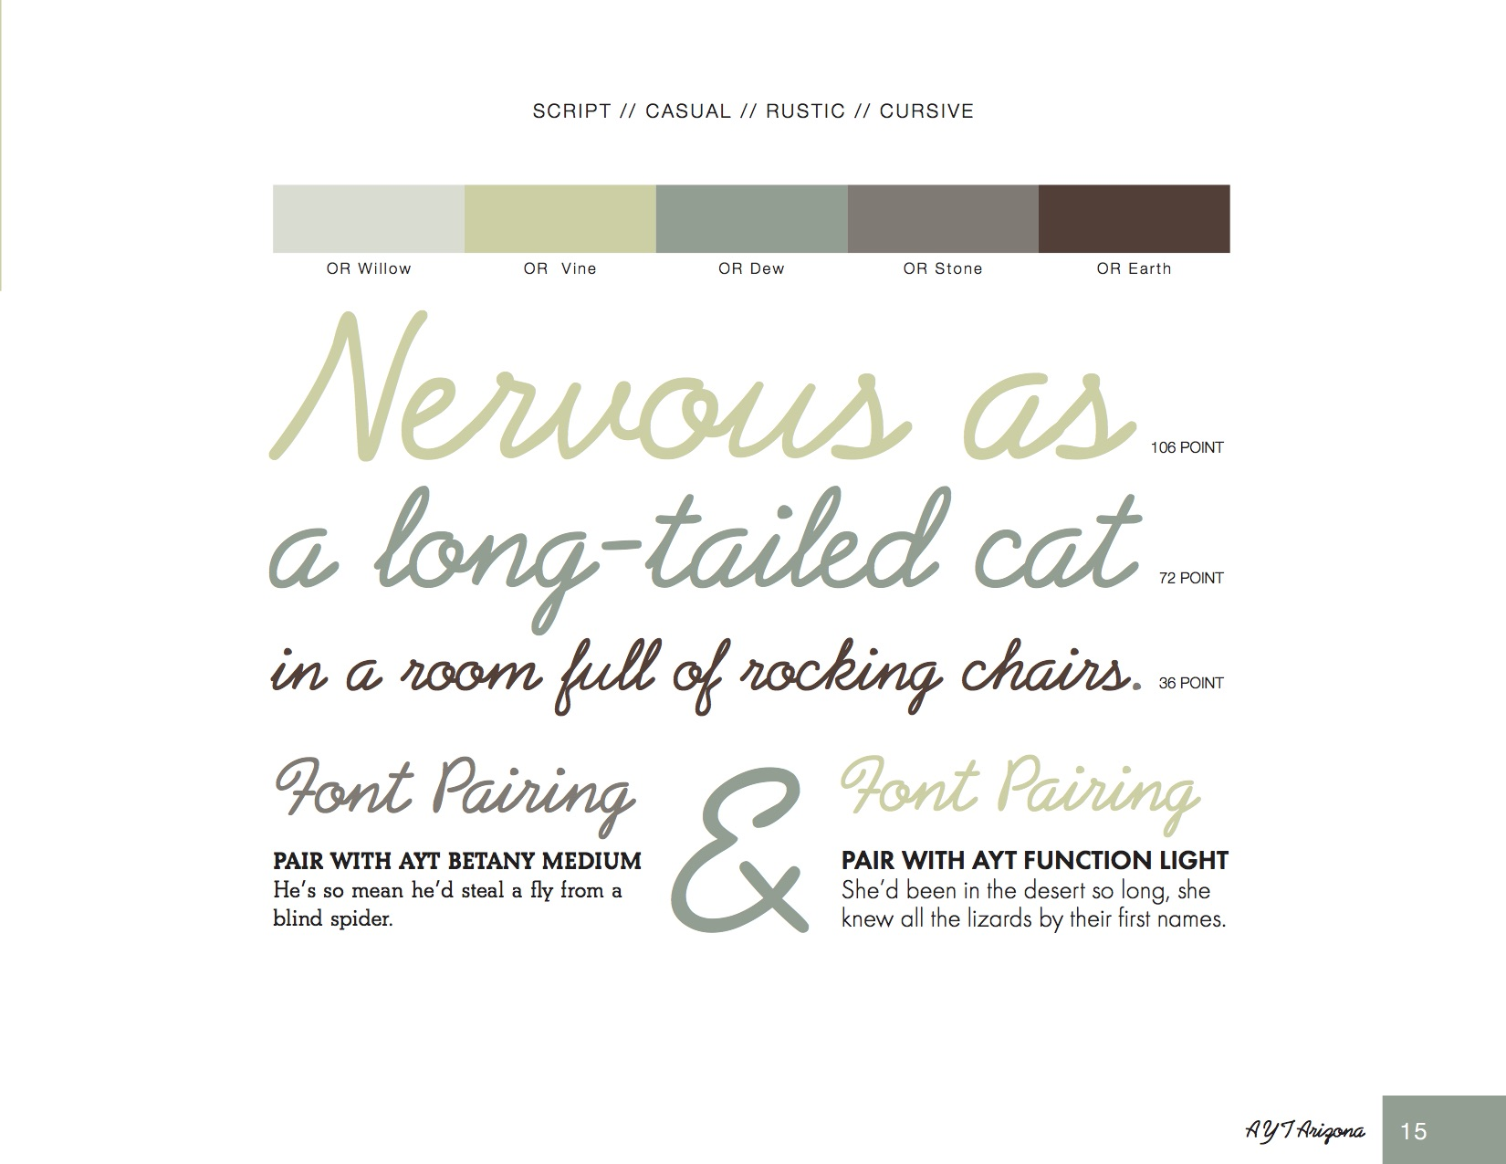
Example Font Pairing
Jostens Font Book
Notes:
In this example on the page, the author paired a script with a readable body copy. Be certain to spend an equal amount of time identifying the size hierarchy throughout the publication. Size hierarchy is where there is a clear style for sizing (body copy 10pt, caption copy 8pt, headline copy 72pt, etc.)

Slide 6
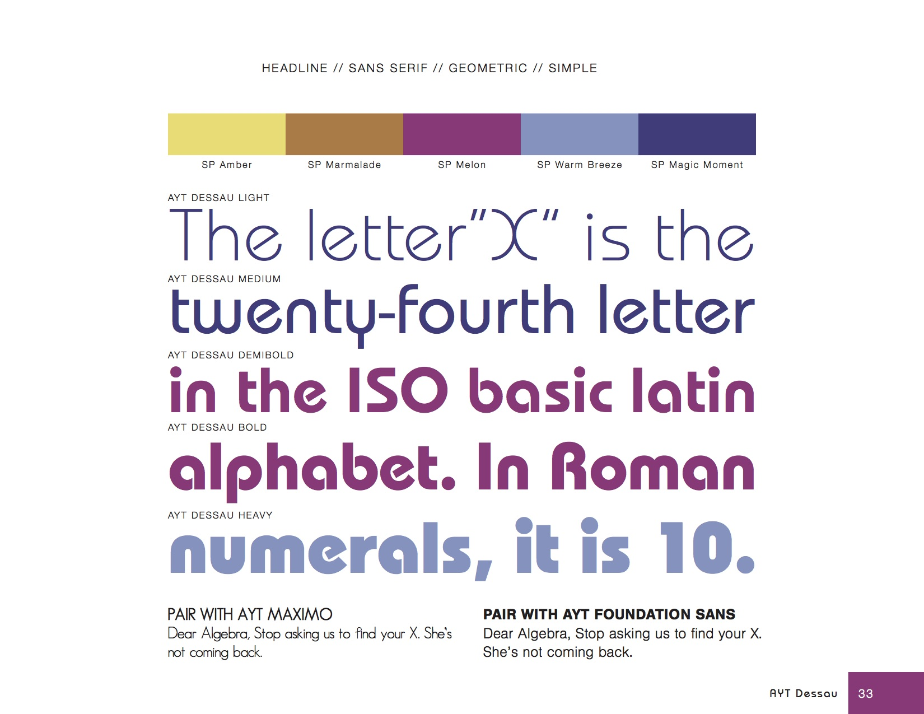
Example Font Pairing
Jostens Font Book
Notes:
Notice how by simply changing the weight (boldness) of the font, the font itself looks drastically different. You could easily use the same font throughout the entire book but simply change the weight for form and function. This is a minimalist but an effective approach to font pairing.

Slide 7
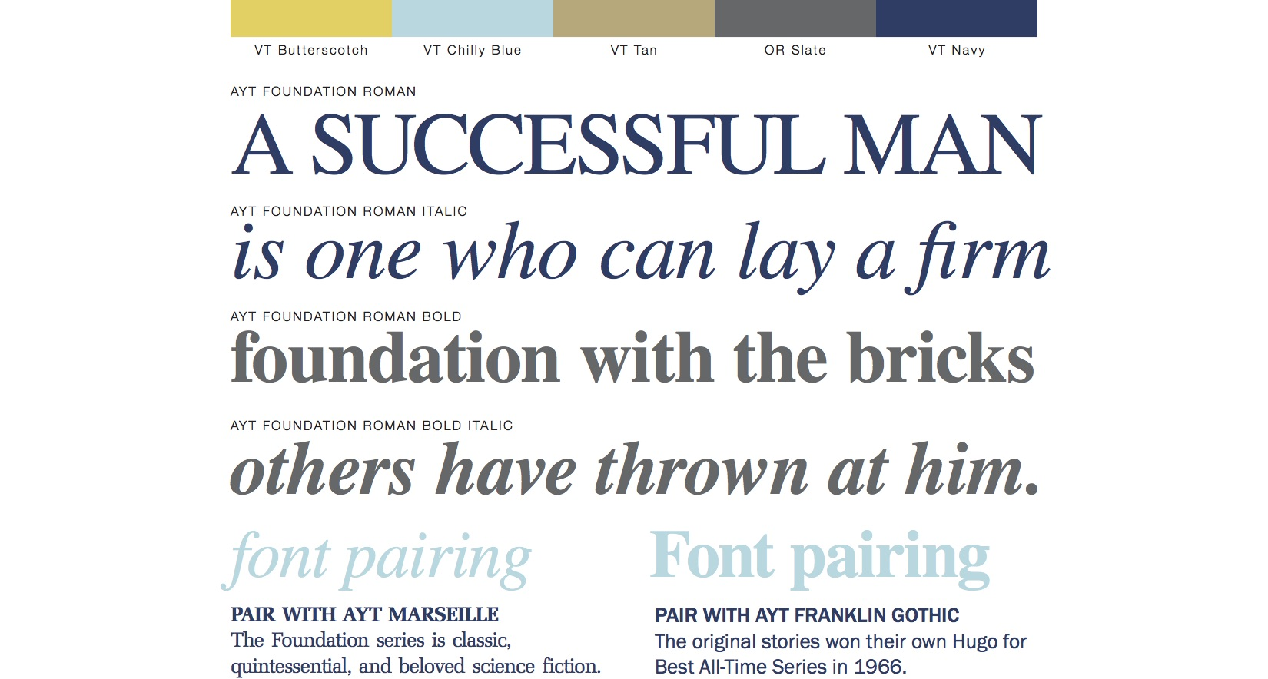
Example Font Pairing
Jostens Font Book
Notes:
Additionally, you can play with each of the font weights to create a differentiated look. For example, use AYT Foundation Sans Roman for the body copy, AYT Foundation Roman Italic for pull-out quotes, AYT Foundation Roman Bold for headlines and so on.

Slide 8
Try to avoid
Using too many fonts
Fonts that are similar
Unreadable font
Notes:
Using too many fonts: using too many fonts throughout the publication creates a disjointed look. In print, it is recommended that the number of fonts does not exceed three or four unique typefaces in the entire publication.
Fonts that are identical. Arial and Helvetica look very similar to the naked eye and will distract viewers. Avoid using fonts that are extremely similar as to avoid the illusion of an oversight.
Unreadable font: Not all fonts are created equal. Be cautious of script and decorative fonts as they tend to become crowded. Our advice: print every page and see if the text is legible. If you have a hard time reading it — even if it’s an extremely cool font — you might need to reconsider it.

Slide 9
Practice
In a group of three or four (depending on class size), pull out the Font Book from the Yearbook Kit or by going to Yearbook Avenue » Digital Classroom » Resources » Font Collection Catalog.
Considering the mood you want your book to convey, choose three fonts and explain why you chose these together in writing.

Slide 10
Use
Utilize font pairing knowledge when creating spreads by thinking about readability, contrast and limiting the number of fonts.

